Slide 2
Software Requirements Engineering
Lecture 2

Slide 3
Contents
Definition of Requirement
Levels of Requirements
2.1 Business Requirements
2.2 User Requirements
2.3 Functional Requirements
Other Types of Requirements
3.1 System Requirements
3.2 Business Rules (not a type of requirement but affects the requirements)
3.3 Non-Functional Requirements
3.4 Feature
3.5 Product vs Project Requirements

Slide 4
Contents
Example to demonstrate different types
Requirements Document
Different Roles in Requirements Engineering
Activities in Requirements Engineering Process
7.1 Requirements Elicitation
7.2 Requirements Analysis
7.3 Requirements Specification
7.4 Requirements Validation
7.5 Requirements Management

Slide 5
1. What is Requirement
Business Rule
Business Requirement
Contraints
Process Requirement
System Requirement
User requirement
User Story
Feature
Functional Requirement
Product
Requirement
Non-Functional Requirement

Slide 6
1. Definition of Requirement
A requirement is “anything that drives design choices” (Lawrence 1997).
The whole point of developing requirements is to make appropriate design choices that will meet the customer’s needs in the end.
A requirement is a property that a product must have to provide value to a stakeholder.
“Requirements are a specification of what should be implemented. They are descriptions of how the system should behave, or of a system property or attribute. They may be a constraint on the development process of the system.” (Ian Sommerville and Pete Sawyer, 1997)
This definition acknowledges the diverse types of information that collectively are referred to as “the requirements.”

Slide 7
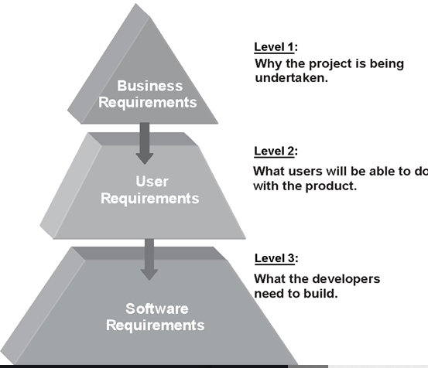
2. Levels of Requirements
Level 1
Why the product is being developed?
Level 2
What the users will be able to do with the product
Level 2
What the developer need to develop to meet the user requirements

Slide 8
2.1 Level 1 - Business Requirements
Business requirements describe why the organization is implementing the system—the business benefits the organization hopes to achieve.
The focus is on the business objectives of the organization or the customer who requests the system.
Suppose an airline wants to reduce airport counter staff costs by 25 percent.
Building a kiosk that passengers can use to check in for their flights at the airport.
Origin: Business requirements typically come from the funding sponsor for a project, the acquiring customer, the manager of the actual users, the marketing department, or a product visionary.
We record the business requirements in a vision and scope document.

Slide 9
2.2 Level 2 - User Requirements
User requirements describe what the user will be able to do with the system.
Origin: Ideally, actual user representatives will provide this information.
Ways to represent user requirements include use cases, user stories and event-response tables.
An example of a use case is “Check in for a flight” using an airline’s website or a kiosk at the airport. Written as a user story, the same user requirement might read: “As a passenger, I want to check in for a flight so I can board my airplane.”
Most projects have multiple user classes, as well as other stakeholders whose needs also must be elicited.

Slide 10
2.3 Level 3 - Functional Requirements
Functional requirements specify the behaviors the product will exhibit under specific conditions.
They describe what the developers must implement to enable users to accomplish their tasks (user requirements), thereby satisfying the business requirements.
This alignment among the three levels of requirements is essential for project success.
Functional requirements often are written in the form of the traditional “shall” statements:
“The Passenger shall be able to print boarding passes for all flight segments for which he has checked in” or “If the Passenger’s profile does not indicate a seating preference, the reservation system shall assign a seat.”

Slide 11
2.3 Level 3 - Functional Requirements
The Business Analyst (BA) document functional requirements in a software requirements specification (SRS), which describes as fully as necessary the expected behavior of the software system.
“Business analyst” refers to the project role that has primary responsibility for leading requirements-related activities on a project.
The SRS is used in development, testing, quality assurance, project management, and related project functions.

Slide 12
3. Other Types of Requirements
System Requirements
Business Rules (not a type of requirement but affects the requirements)
Non-Functional Requirements
Feature
Product vs Project Requirements

Slide 13
3.1 System Requirements
System requirements describe the requirements for a product that is composed of multiple components or subsystems.
A system can be all software or it can include both software and hardware subsystems. People and processes are part of a system, too, so certain system functions might be allocated to human beings.
The term “system requirements” is also used to mean the detailed requirements for a software system, but that’s not how we use the term in this course.

Slide 14
3.1 Example of System Requirements
A good example of a “system” is the cashier’s workstation in a supermarket.
There’s a bar code scanner integrated with a scale, as well as a hand-held bar code scanner. The cashier has a keyboard, a display, and a cash drawer. You’ll see a card reader and PIN pad for your loyalty card and credit or debit card, and perhaps a change dispenser. You might see up to three printers for your purchase.

Slide 15
3.2 Business Rules
Business rules include corporate policies, government regulations, industry standards, and computational algorithms.
Business rules are not themselves software requirements because they have an existence beyond the boundaries of any specific software application.
However, they often dictate that the system must contain functionality to comply with the rules.
We can trace the origin of certain functional requirements back to a particular business rule.
Example:

Slide 16
3.3 Non-functional Requirements
In addition to functional requirements, the SRS contains an assortment of non-functional requirements.
Non-functional (other-than functional) requirements might specify not what the system does, but rather how well it does those things.
Non-functional Requirements
Quality Attributes
Constraints
External Interfaces

Slide 17
3.3 Non-functional Requirements
Quality attributes are also known as quality factors, quality of service requirements, and the “–ilities.”
They describe the product’s characteristics in various dimensions that are important either to users or to developers and maintainers, such as performance, safety, availability, and portability.
External Interfaces include connections to other software systems, hardware components, and users, as well as communication interfaces.

Slide 18
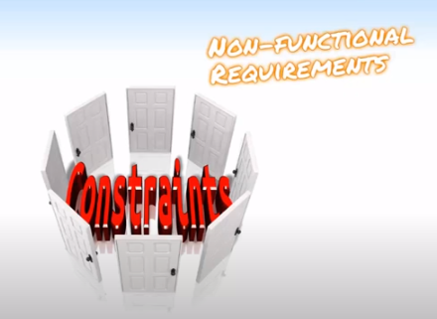
3.3 Non-functional Requirements
A constraint is a restriction on the degree of freedom you have in providing a solution.
Constraints can be economic, political, technical, or environmental and pertain to your project resources, schedule, target environment, or to the system itself.
Design and implementation constraints impose restrictions on the options available to the developer during construction of the product.
Examples
The system will work on our existing technical infrastructure - no new technologies will be introduced.
The system will only use the data contained in the existing corporate database.
The system shall be available 99.99% of the time for any 24-hour period.
All master's degree programs must include the development of a thesis.

Slide 19
3.4 Feature
A feature consists of one or more logically related system capabilities that provide value to a user and are described by a set of functional requirements.
A customer’s list of desired product features is not equivalent to a description of the user requirements.
A feature can encompass multiple user requirements, each of which implies that certain functional requirements must be implemented to allow the user to perform the task described by each user requirement.
Examples: Web browser bookmarks, spelling checkers, the ability to define a custom workout program for a piece of exercise equipment, and automatic virus signature updating in an anti-malware product are examples of features.
The following figure illustrates a feature tree, an analysis model that shows how a feature can be hierarchically decomposed into a set of smaller features, which relate to specific user requirements and lead to specifying sets of functional requirements (Beatty and Chen 2012).

Slide 20
Feature Tree

Slide 21
3.5 Product vs Project Requirements
Product vs Project
A project has a defined beginning and end in time and is unique in that it is not a routine operation, but a specific set of operations designed to accomplish a singular goal.
A product is a good, service, platform, application, system, etc. that is created, maintained and supported by solving problems and providing benefits to specific customer and business needs.

Slide 22
3.5 Product vs Project Requirements
So far we have been discussing requirements that describe properties of a software system to be built. These are product requirements.
Projects certainly do have other expectations and deliverables that are not a part of the software the team implements, but that are necessary to the successful completion of the project as a whole. These are project requirements but not product requirements.

Slide 23
3.5 Examples of Project Requirements
Physical resources the development team needs, such as workstations, special hardware devices, testing labs, testing tools and equipment, team rooms, and videoconferencing equipment.
Staff training needs.
User documentation, including training materials, tutorials, reference manuals, and release notes.
Support documentation, such as help desk resources
Infrastructure changes needed in the operating environment.
Requirements and procedures for releasing the product, installing it in the operating environment, configuring it, and testing the installation.
Requirements and procedures for transitioning from an old system to a new one, such as data migration and conversion requirements, security setup, production cutover, and training to close skills gaps; these are sometimes called transition requirements.

Slide 24
3.5 Some more examples of Project Requirements
Product certification and compliance requirements.
Sourcing, acquisition, and licensing of third-party software and hardware components.
Beta testing, manufacturing, packaging, marketing, and distribution requirements.
Requirements for obtaining legal protection (patents, trademarks, or copyrights) for intellectual property related to the software.

Slide 25
4. Example to demonstrate different types of Requirements
Consider a project to develop the next version of a text editor program.
Increase non-US sales by 25 percent within 6 months
Business Requirement
A multi-language spelling checker feature
Feature
User Requirements
Select language for spelling checker
Find spelling errors
Add a word to a dictionary
displaying suggested replacements, and globally replacing misspelled words with corrected words
Usability Requirement specifies how the software is to be localized for use with specific languages and character sets
Highlighting misspelled words
Autocorrect
Functional Requirements
Non-Functional Requirement

Slide 26
5. Requirements Document
Requirements documents do not have to be traditional paper or electronic documents.
Think of them simply as containers in which to store requirements knowledge.
Such a container could indeed be a traditional document, or it could be a spreadsheet, a set of diagrams, a database, a requirements management tool, or some combination of these.

Slide 27
5. Relationships among several types of requirements information
The ovals represent
types of requirements information
The rectangles indicate documents
in which to store that information
The solid arrows indicate that a certain type of information typically is stored in
the indicated document.
The dotted arrows indicate that one type of
information is the origin of or influences
another type of requirement.

Slide 28
6. Different Roles in Requirements Engineering

Slide 29
7. Activities in Requirements Engineering Process
Requirements Elicitation
Requirements Analysis
Requirements Specification
Requirements Validation
Requirements Management

Slide 30
7.1 Requirements Elicitation
Elicit means “ to evoke or draw out (a reaction, answer, or fact) from someone”.
Elicitation Techniques
interviews,
workshops,
document analysis
prototyping, and others.
The key actions are:
Identifying the product’s expected user classes and other stakeholders.
Understanding user tasks and goals and the business objectives with which those tasks align.
Learning about the environment in which the new product will be used.
Working with individuals who represent each user class to understand their functionality needs and their quality expectations.

Slide 31
7.2 Requirements Analysis
Analysis is the process of breaking a complex topic or substance into smaller parts in order to gain a better understanding of it
Reaching a richer and more precise understanding of each requirement and representing sets of requirements in multiple ways.
Principal activities:
Analyzing the information received from users to distinguish their task goals from functional requirements, quality expectations, business rules, suggested solutions, and other information
Decomposing high-level requirements into an appropriate level of detail
Deriving functional requirements from other requirements information
Understanding the relative importance of quality attributes
Allocating requirements to software components defined in the system architecture
Negotiating implementation priorities
Identifying gaps in requirements or unnecessary requirements as they relate to the defined scope

Slide 32
7.3 Requirements Specification
Requirements specification involves representing and storing the collected requirements knowledge in a persistent and well-organized fashion.
The principal activity is:
Translating the collected user needs into written requirements and diagrams suitable for comprehension, review, and use by their intended audiences.

Slide 33
7.4 Requirements Validation
Requirements validation confirms that you have the correct set of requirements information that will enable developers to build a solution that satisfies the business objectives.
The central activities are:
Reviewing the documented requirements to correct any problems before the development group accepts them.
Developing acceptance tests and criteria to confirm that a product based on the requirements would meet customer needs and achieve the business objectives.

Slide 34
7.5 Requirements Management

Slide 35
7.6 Requirements Management
Requirements management activities include the following:
Defining the requirements baseline, a snapshot in time that represents an agreed-upon, reviewed, and approved set of functional and nonfunctional requirements, often for a specific product release or development iteration
Evaluating the impact of proposed requirements changes and incorporating approved changes into the project in a controlled way
Negotiating new commitments based on the estimated impact of requirements changes
Defining the relationships and dependencies that exist between requirements
Tracing individual requirements to their corresponding designs, source code, and tests
Tracking requirements status and change activity throughout the project

